Slide 1
SYMPTOM BASED DISEASE PREDICTION USING MULTIPLE MODELS
By
ANUSHA METTU

Slide 2
INTRODUCTION
Our project addresses this issue by using machine learning algorithms as a powerful method of data analysis.
We've gathered disease and symptom data in a CSV file, which we are utilizing to develop a user-friendly graphical interface.
Our model accurately predicts diseases by analyzing the symptoms with multiple machine learning algorithms.
This approach is especially critical because symptoms can vary among different individuals, even when they have the same disease.
Our goal is to create a reliable, accessible tool that can serve as a first step in disease diagnosis for people who may not have regular access to diagnostic centers.
By providing this resource, we hope to help people take necessary precautions and improve their quality of life.

Slide 3
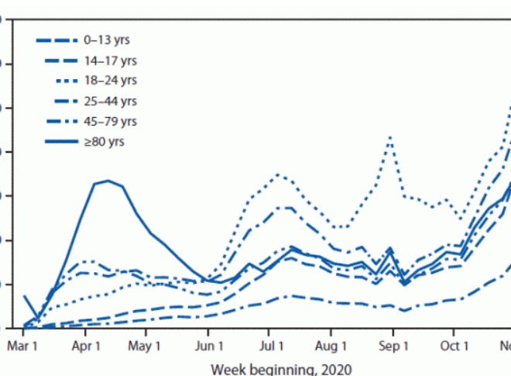
PROBLEM STATEMENT
The healthcare industry has grown into a multibillion-dollar enterprise. The healthcare business generates vast amounts of health-care data on a regular basis, which can be utilized to extract information for forecasting sickness that may occur to a patient in the future utilizing treatment history and health data. This hidden information in healthcare data will be used afterwards to make affective health decisions for patients. This sector also needs to be improved by utilizing informative data in healthcare. So here is one of method for analyzing and predicting the disease from their symptoms using the machine learning.

Slide 4
OBJECTIVE
The primary objective of this project is to develop a user-friendly model that can accurately predict a disease based on the symptoms provided by the user.
To achieve this, the model will utilize advanced machine learning algorithms that will be run simultaneously for the same set of symptoms.
This will improve the accuracy of disease detection, as symptoms can vary from person to person even for the same illness.
Moreover, the project will include the development of a customized user interface that will allow the user to input their symptoms and select their preferred algorithm for disease detection.
aims to provide a reliable and accessible tool that can serve as an initial step in the diagnosis of diseases based on the symptoms presented.

Slide 5
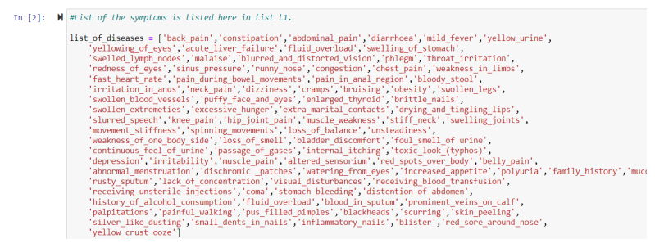
DATA SET COLLECTION
We have divided our data into two sets. One is training data set and the other one is testing data set. In our data set we have 133 rows. In this we will have 132 rows that collects data regarding the symptoms of disease and the last column explain type of disease.

Slide 6
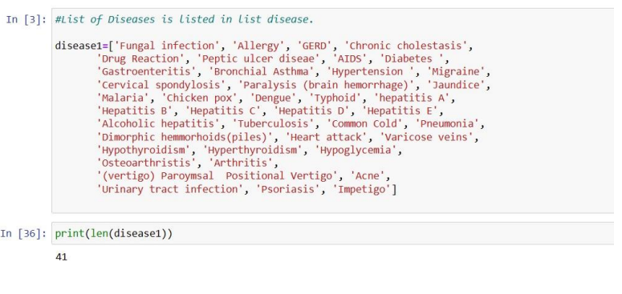
DATA SET COLLECTION
So here we have 132 attributes, and each attribute is a symptom for a particular disease. And a particular set of symptoms leads to a specific disease. Similarly, we have 41 number of rows that explains the different possible types of disease that may occur due to a particular set of symptoms.

Slide 7
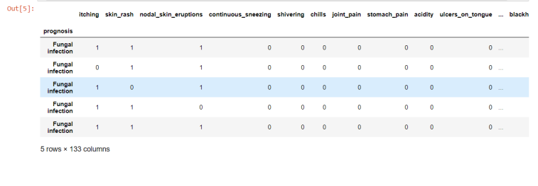
DATA SET COLLECTION
Displaying the symptoms and the diseases caused by the set of symptoms.

Slide 8
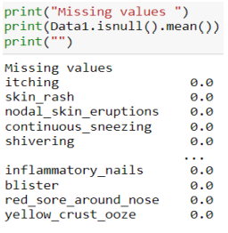
DATA CLEANING
Missing data
In our data set we do not have any missing data. Our data set is clean.

Slide 9
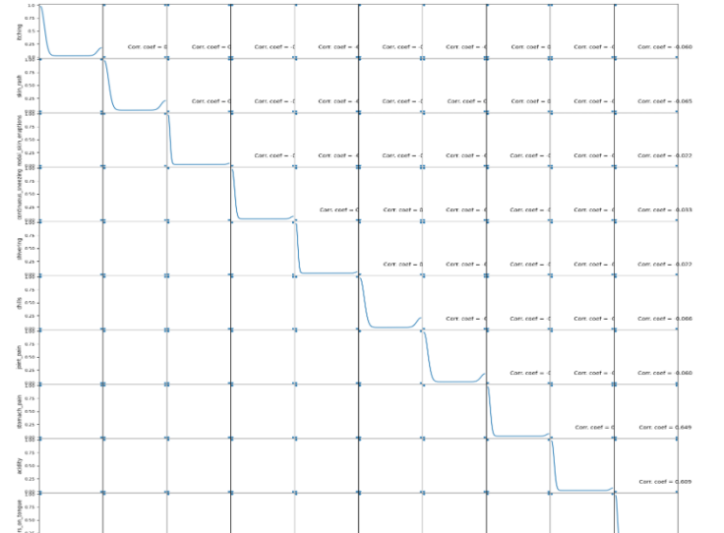
DATA CLEANING
DATA VISUALIZATION USING SCATTER PLOT
We have used scatter to visualize our data. This plot helps us to find the relation between each attribute.

Slide 10
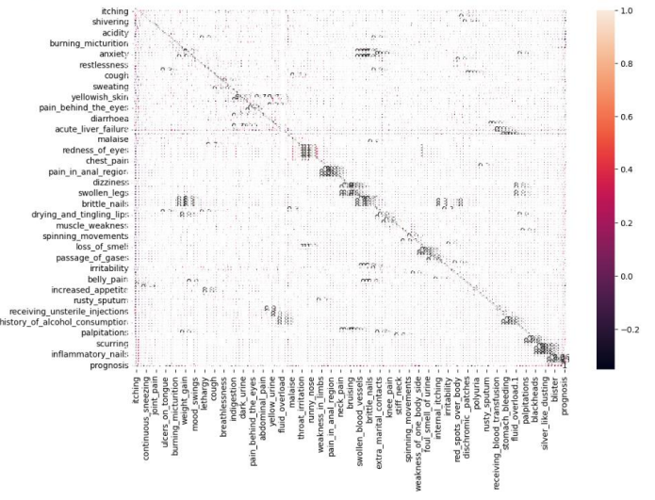
DATA CLEANING
Correlation matrix:
The correlation matrix helps us to find out correlation between each variable. Using this plot, we can know if a particular variable has effect in our model or not.
Using this table, we can figure out that every variable has its own significance. Hence all the variables should be used while the testing process.

Slide 11
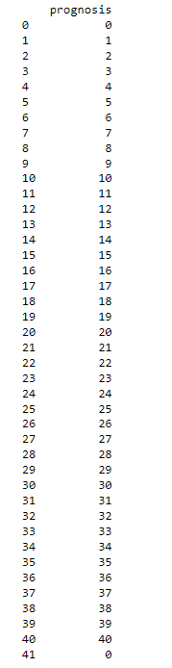
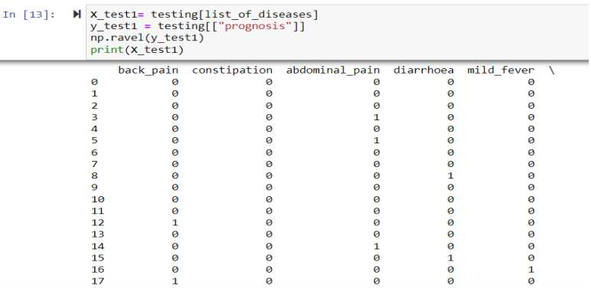
DATA PROCESSING
We have converted the data into binary form as it will be efficient for the model to work in binary format.
We do X-test and Y test to our model. X- test is used to test the independent variables. Y-Test is used to test the dependent variables.

Slide 12
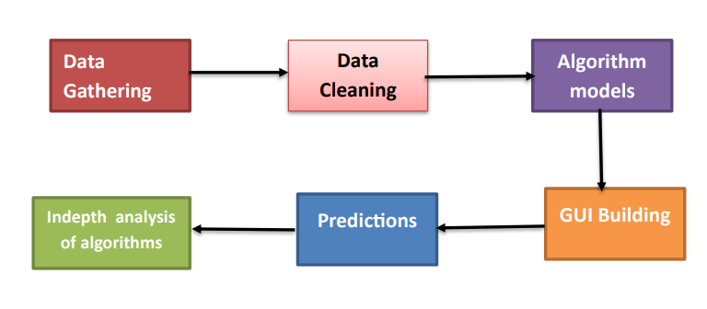
FRAMEWORK
The given dataset comprises of binary data, represented by 0s and 1s. Therefore, it is imperative to eliminate any missing values from the dataset to ensure its accuracy. Following this, the data labels are transformed into numerical format, and the dataset is segregated into two parts, namely training and testing.
Specifically, 80% of the dataset is allocated for training, and the remaining 20% is reserved for testing purposes.
To construct our model, we have employed the K-fold cross-validation technique along with popular machine learning algorithm such as Decision Tree.
To construct our model, we have employed the K-fold cross-validation technique along with popular machine learning algorithms such as Decision Tree, Random Forest, and Naive Bayes classifier.
To facilitate the process of disease prediction, we have developed a Python GUI that accepts users' symptoms as input, and then machine learning algorithms are employed to predict the possible disease based on the given symptoms.

Slide 13
IMPLEMENTATION
We have used three different models:
Decision tree
Random forest
Navie Bayes

Slide 14
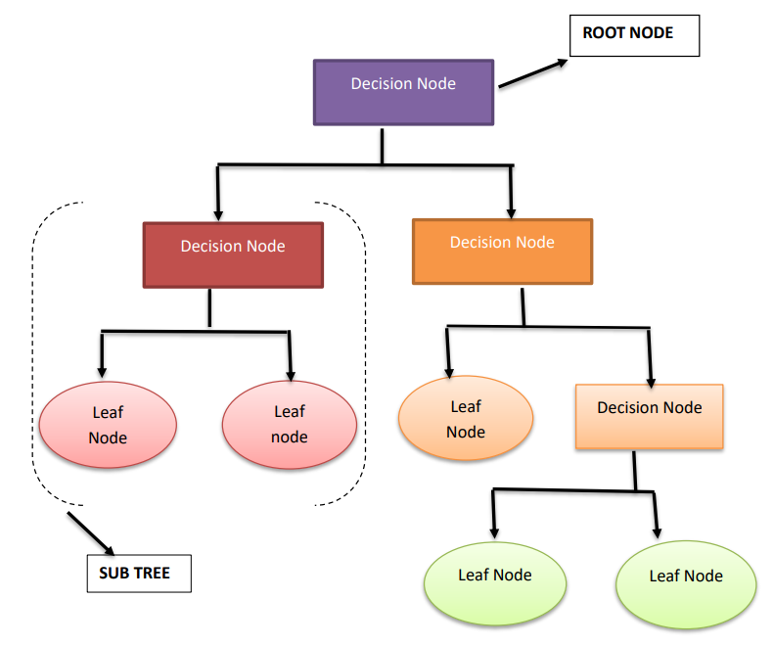
DECISION TREE
Decision Trees are a versatile supervised learning method that can effectively tackle classification and regression problems. While they are suitable for both, Decision Trees are most commonly used for classification tasks. These tree-structured classifiers have internal nodes that denote the dataset's features, branches representing decision rules, and leaf nodes that represent the final outcomes.

Slide 15
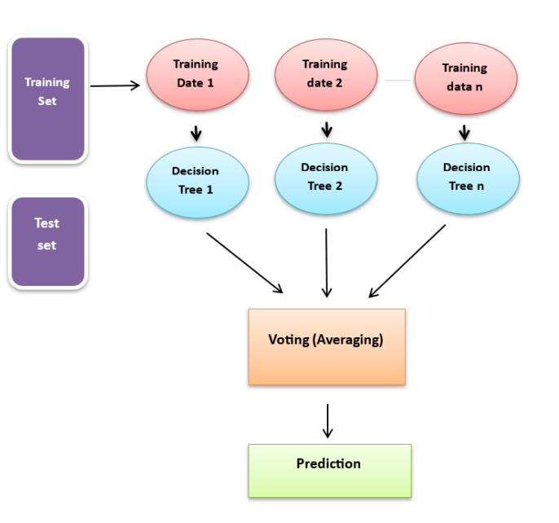
RANDOM FOREST
A random forest is a machine learning technique that utilizes ensemble learning to solve classification and regression problems. This algorithm consists of many decision trees that are trained through bagging or bootstrap aggregating. By taking the average or mean of the output from various trees, the random forest predicts the outcome based on the predictions of the decision trees. Increasing the number of trees increases the precision of the outcome. This technique overcomes the limitations of a decision tree algorithm, reduces overfitting of datasets, increases precision, and generates predictions without requiring many configurations in packages.

Slide 16
NAVIE BAYES
The algorithm is a supervised learning technique that utilizes Bayes' theorem for solving classification problems. This algorithm is particularly useful for text classification problems that involve high-dimensional training datasets. The Naïve Bayes classifier is a simple yet highly effective classification algorithm that facilitates the speedy construction of machine learning models capable of quick predictions. As a probabilistic classifier, it relies on the object's probability to make predictions. Several applications of the Naïve Bayes algorithm exist, including spam filtration, sentimental analysis, and article classification.
P(A|B) =[ P(B|A) * P(A) ] / P(B)

Slide 17
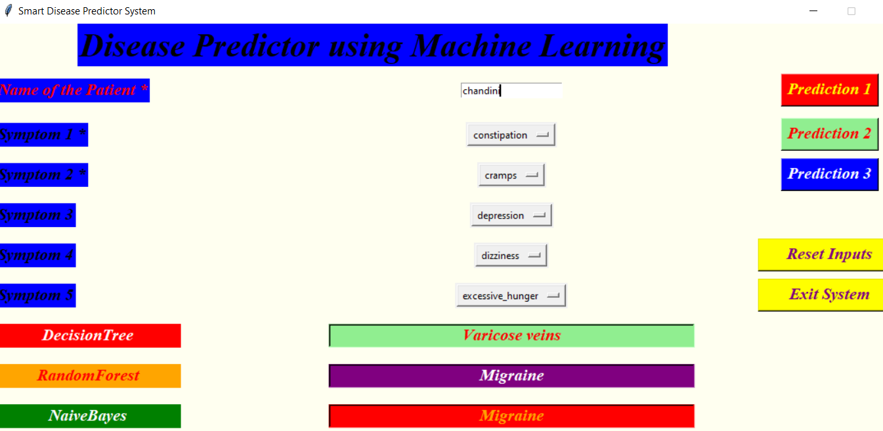
OUTPUT

Slide 18
CHALLENGES
The dataset used for this project was extensive, which made it time-consuming to remove irrelevant data during the cleaning process.
Developing a customized graphical user interface specific to this project presented challenges as the entire interface was built through hard-coding.
Additionally, selecting the most suitable classifier from the many machine learning classifiers available was a challenging task.
Moreover, enhancing the accuracy of the selected classifier is a time-consuming process. Despite these challenges, the project aims to deliver reliable disease diagnosis by utilizing advanced machine learning techniques.

Slide 19
FUTURE WORK
Present model we are using only 3 algorithms for the prediction of disease, but in the future, we plan to give the user an option to select the drop down from the list of n- number of classifiers to choose for prediction.
Improve the accuracy of the current model to the maximum.
We also plan to add more diseases and symptoms to the model.

Slide 20
CONCLUSION
We were able to achieve the 93% accuracy on an average.
With a system like this people who do not have access to diagnosis center can find the disease and take the precautionary steps as first step pf treatment.
We have included method for storing the user input which can be used in the future to build a better version .
We were also able to see how different supervised machine learning algorithms work and were analyzed as well. It provided insight into how technologies such as machine learning can help the healthcare industry.

